Slide 1

Capstone Project – Final: Review – 1 on
DISCOVERING MENTAL DISORDERS AND LEVERAGING CONTRASTIVE LEARNING
Presented by the Batch No. : CSE-91
V.SHEELA MADHURI BU22CSEN0101860 (TL)
MONICA R BU22CSEN0102297
MANASA M BU22CSEN0102305
SINDHURA S BU22CSEN0102308
Under the Guidance of
Dr.Chintoo Kumar
Assistant Professor
Department of Computer Science and Engineering
GITAM School of CSE, GITAM (Deemed to be University),
Bengaluru, Karnataka, INDIA.

Slide 2
CONTENTS
Recap of Capstone Project Introduction Review-2
  Problem Statement
  Objectives and Project Workflow
  Feedback from Guide/Reviewers and actions taken after Review–2
Methodology/Algorithms
Status of Implementation
Conclusion
References

Slide 3
Problem Statement
Mental disorders remain underdiagnosed due to stigma and lack of accessible tools.Existing solutions depend on questionnaires or small datasets.
Challenge: Build a scalable, accurate, and ethical detection system.

Slide 4
Objectives
Identify relevant datasets (surveys, clinical, social media).Apply ML/DL techniques for classification (depression, anxiety, bipolar, etc.).Leverage study/learning-based analysis to recommend coping strategies.Develop a prototype system for testing.

Slide 5
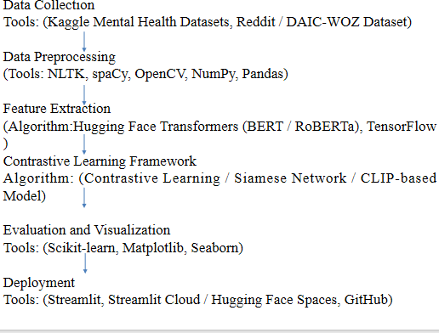
Design Strategy
Project Workflow

Slide 6
Feedback from Guide/Reviewers and actions taken after Review–2
Feedback from Guide/Reviewers
1. Dataset description was insufficient.
2. Model architecture explanation needs improvement.
3.Team participation during the presentation was uneven.
Actions taken
1. Detailed information about the dataset and preprocessing steps was added.
2.The model architecture was clearly explained with a simple block diagram.
3.Responsibilities were redistributed to ensure equal involvement of all team members.

Slide 7
CONTENTS
Recap of Capstone Project Introduction Review-2
  Problem Statement
  Objectives and Project Workflow
  Feedback from Guide/Reviewers and actions taken after Review–2
Methodology/Algorithms
Status of Implementation
Conclusion
References

Slide 8
Methodology
Data Collection
Mental health–related data is collected from reliable and relevant sources.
Data Preprocessing
The data is cleaned, normalized, and prepared for model training.
Feature Extraction
Important features are extracted to represent mental health patterns effectively.
Contrastive Learning
A contrastive learning model is used to learn meaningful and discriminative representations.
Model Training
The model is trained using contrastive loss to improve learning quality.
Classification
The learned representations are used to classify different mental disorders.
Evaluation
The model performance is measured using standard evaluation metrics.

Slide 9
Algorithm (s)
Contrastive Learning (SimCLR / Contrastive Loss)
Used to learn meaningful representations by bringing similar data closer and separating dissimilar data.
Neural Networks (Deep Learning Model)
Used to automatically learn complex patterns from mental health data.
Convolutional Neural Network (CNN)
Applied when using audio or image-based features to extract spatial patterns.
Recurrent Neural Network (LSTM / GRU)
Used for sequential data such as speech signals or time-series mental health data.
Support Vector Machine (SVM)
Used as a baseline classifier to compare performance with the proposed model.
Softmax Classifier
Classifies mental disorders into different categories.

Slide 10
CONTENTS
Recap of Capstone Project Introduction Review-2
  Problem Statement
  Objectives and Project Workflow
  Feedback from Guide/Reviewers and actions taken after Review–2
Methodology/Algorithms
Status of Implementation
Conclusion
References

Slide 11
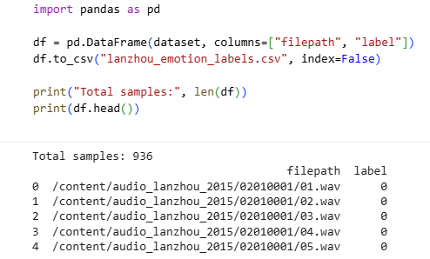
Status of Implementation

Slide 12
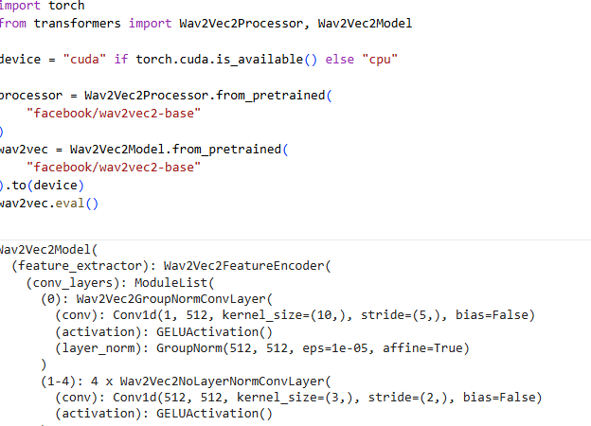
Status of Implementation

Slide 13
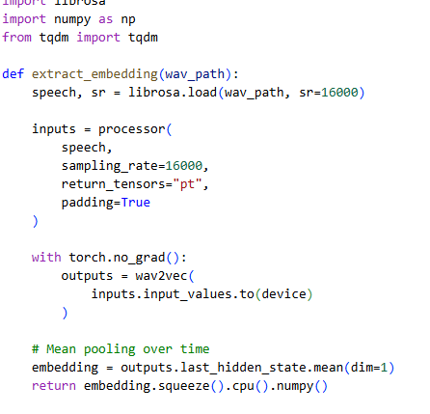
Status of Implementation

Slide 14
CONTENTS
Recap of Capstone Project Introduction Review-2
  Problem Statement
  Objectives and Project Workflow
  Feedback from Guide/Reviewers and actions taken after Review–2
Methodology/Algorithms
Status of Implementation
Conclusion
References

Slide 15
Conclusion
The project has made good progress, and the team is confident about completing it successfully. By using contrastive learning, the model is expected to improve the detection of mental disorders with better accuracy. The project can help in early diagnosis and support mental healthcare using AI.

Slide 16
CONTENTS
Recap of Capstone Project Introduction Review-2
  Problem Statement
  Objectives and Project Workflow
  Feedback from Guide/Reviewers and actions taken after Review–2
Methodology/Algorithms
Status of Implementation
Conclusion
References

Slide 17
References
1. Devlin, J., Chang, M. W., Lee, K., & Toutanova, K. (2019). BERT: Pre-training of deep bidirectional transformers for language understanding. Proceedings of NAACL-HLT.
2. Radford, A., Kim, J. W., Hallacy, C., et al. (2021). Learning transferable visual models from natural language supervision (CLIP). arXiv preprint arXiv:2103.00020.
3. Rejaibi, E., et al. (2022). A deep learning-based approach for detecting mental disorders from social media texts. IEEE Access, 10, 34756–34768.
4. Yang, S., et al. (2020). Deep multimodal representation learning for mental disorder detection. Proceedings of the 28th ACM International Conference on Multimedia (ACM MM).
5. Li, Y., et al. (2023). Contrastive learning for multimodal mental health analysis. Pattern Recognition Letters, 165, 96–104.

Slide 18
6. Kingma, D. P., & Ba, J. (2015). Adam: A method for stochastic optimization. International Conference on Learning Representations (ICLR).
7. Mikolov, T., Sutskever, I., Chen, K., Corrado, G. S., & Dean, J. (2013). Distributed representations of words and phrases and their compositionality. Advances in Neural Information Processing Systems (NeurIPS).
8. Tadesse, M. M., Lin, H., Xu, B., & Yang, L. (2019). Detection of depression-related posts in Reddit social media forum. IEEE Access, 7, 44883–44893.
9. Wang, Y., et al. (2022). Multimodal deep learning for mental health prediction: A systematic review. Journal of Biomedical Informatics, 130, 104062.
10. OpenAI. (2023). Contrastive learning and representation techniques for emotion and mental health detection.

